Slide 1
ALGORITHM ANALYSIS

Slide 2

OPERATION COUNT
For i= 1 to n do
For j=1 to n do
A=B x C
End for
End for
Operation count – if only multiplication is taken into account
Multiplication is done n x n times as the operation is performed inside two loops both from 1 to n

Slide 3
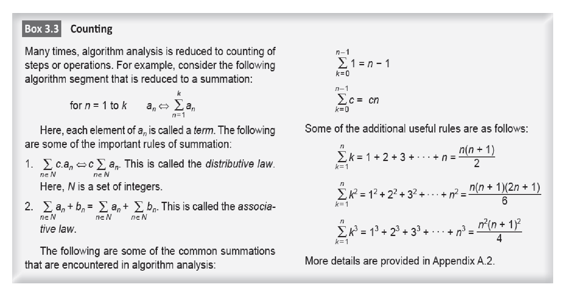
NEED FOR COUNTING

Slide 4
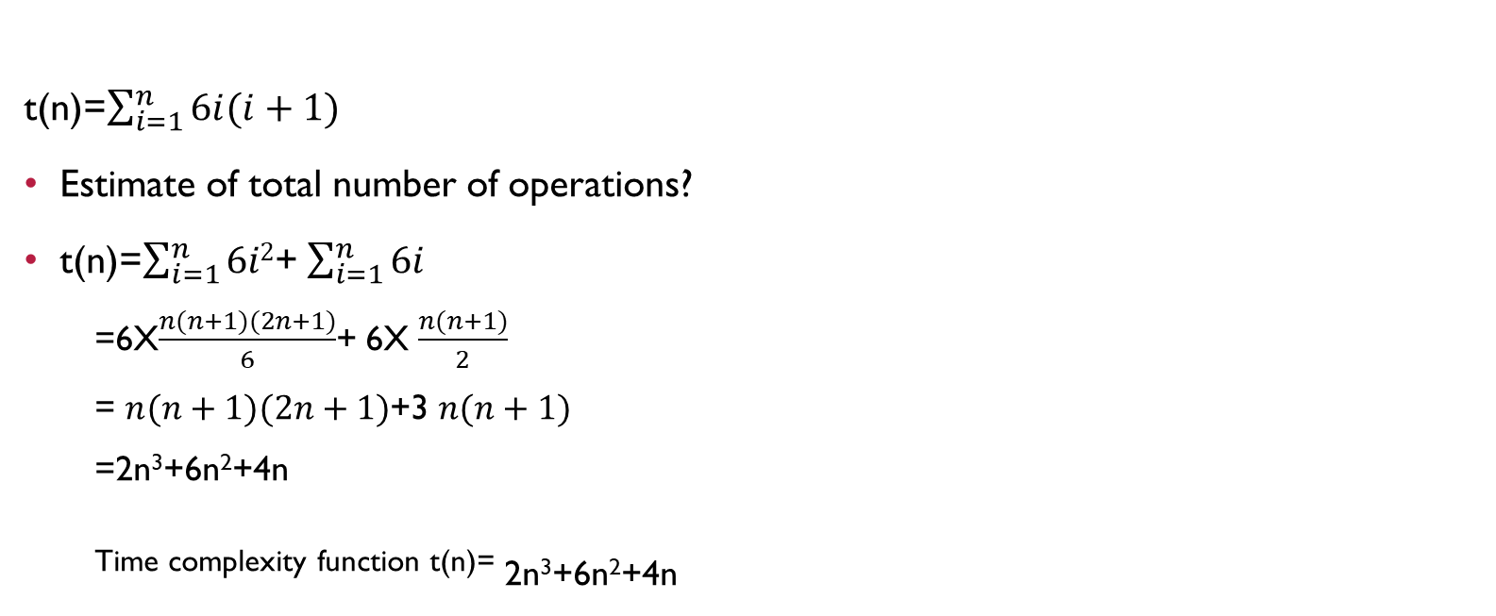

Slide 5
WORST CASE COMPLEXITY
Defines T(n) as a complexity function W(n) of the worst- case input for which the algo takes maximum time
Causes a computer to run slower
Algo needs to perform the maximum number of steps or operations to process the input for accomplishing the given task
Maximum no. of steps taken on any instance of size
W(n) = max(T₁(n), T₂(n), …).

Slide 6
BEST CASE COMPLEXITY
Minimum computation time of the algo for all the instances of the domain
Domain is the set of all valid inputs of an algorithm
Minimum no. of steps taken on any instance of size
B(n) = min(T₁(n), T₂(n), …).

Slide 7
AVERAGE CASE COMPLEXITY
Average no. of steps taken on any instance of size
Let T1(n), T2(n), … be the execution times for all possible inputs of size n, and let P1(n), P2(n), … be the probabilities of these inputs.
The average-case time complexity is then defined as
A (n)=P1(n)T1(n) + P2(n)T2(n) + …
Average-case time is often harder to compute, and it also requires knowledge of how the input is distributed.

Slide 8
LINEAR SEARCH
Linear Search is a method for finding a target value within a list.
It sequentially checks each element of the list for the target value until a match is found or until all the elements have been searched.

Slide 9
Step1: Start from the leftmost element of array and one by one compare x with each element of array.
Step2: If x matches with an element, return the index.
Step3: If x doesn’t match with any of elements, return -1.

Slide 10
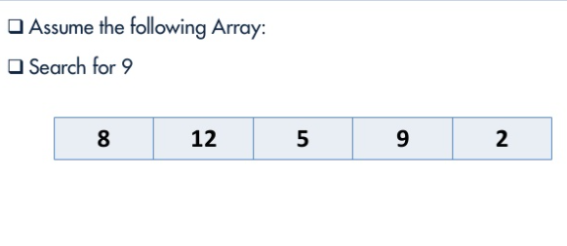

Slide 11
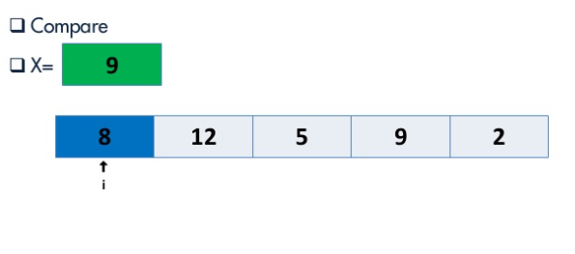

Slide 12
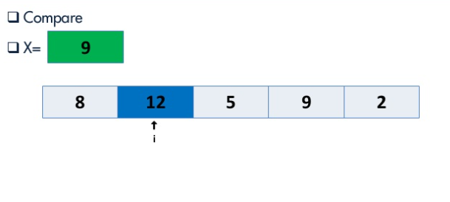

Slide 13
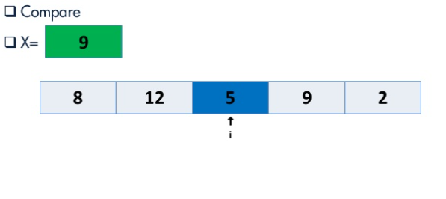

Slide 14
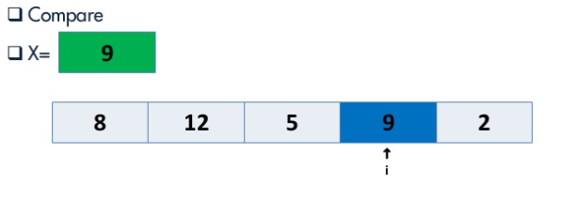

Slide 15
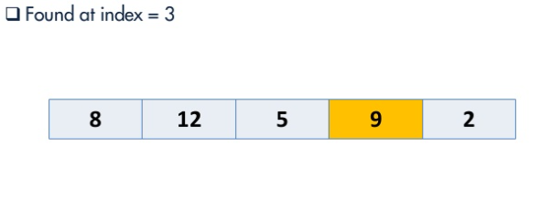

Slide 16
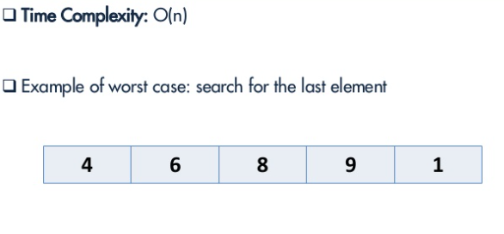

Slide 17
RATE OF GROWTH- HOW ALGORITHM SCALE?
To find behaviour of an algo
If complexity of one algo is significantly larger than that of the other, it is a matter of concern.
Rate at which running time increases as a function of input n.
Measure the complexity of an algorithm t(n) for larger values of n
Compare it with the collection of functions that have the same growth rate so that the algorithm can be classified and ranked

Slide 18
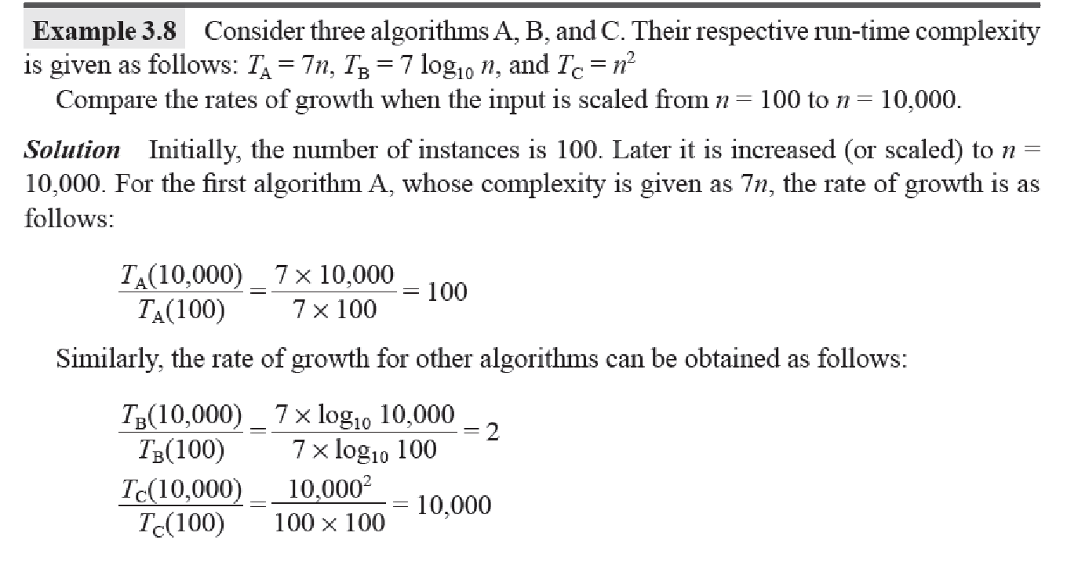
EXAMPLE

Slide 19
EXAMPLE
It can be observed that algo A grows by 100 when the input is scaled from 100 to 10000
The second algo is logarithmic which grows by a factor of 2
Rate of growth of the third algo is around 10000
Therefore second algorithm is better

Slide 20
EXAMPLE 2
T1(n)=n, T2(n)=log₂n, T3(n)=n², T4(n)=2^{n}
2^{n} become large for a larger value
Exponential functions grow at tremendously making computing more difficulr as n grows larger
Input Size | n | log₂n | n² | 2^{n}
1 | 1 | 0 | 1 | 2
10 | 10 | 3.32 | 100 | 1024
100 | 100 | 6.64 | 10⁴ | 10³⁰
1000 | 1000 | 9.96 | 10⁶ | 10³⁰⁰

Slide 21
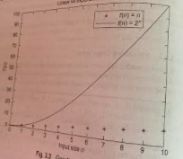
GROWTH OF FUNCTIONS LINEAR VS EXPONENTIAL GROWTH

Slide 22
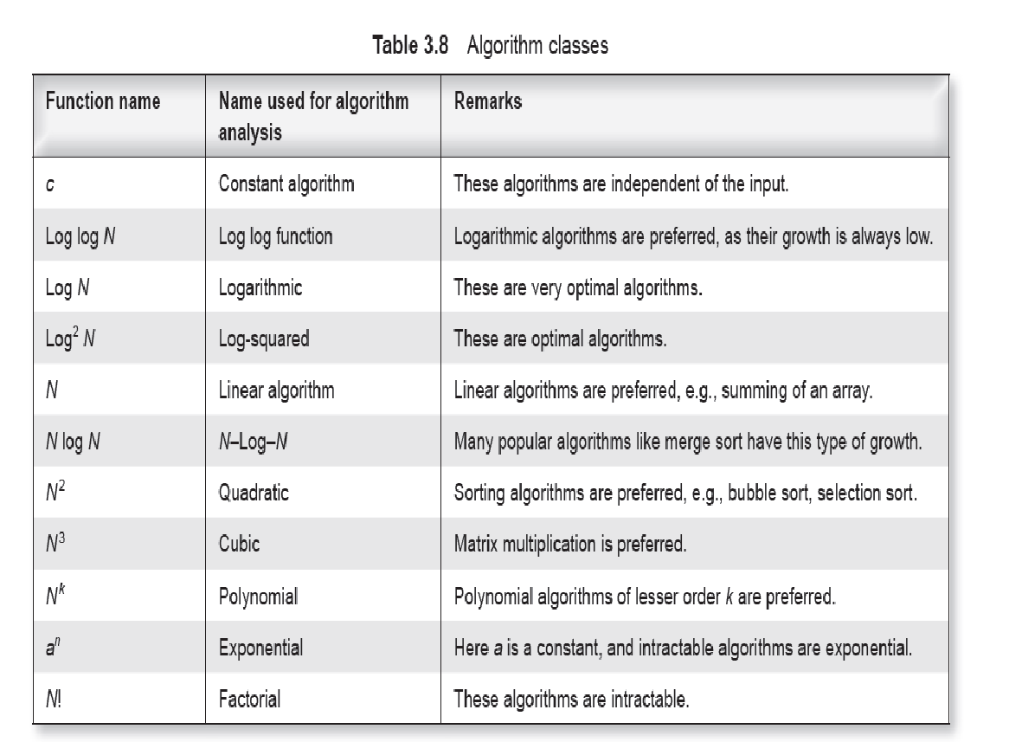

Slide 23
COMPARISON FRAMEWORK
Rate of growth is helpful in comparing two or more algorithms
Example
Let A and B are two algorithms, ta=n² and tb=40n+1200
Find ta = tb
n² =40n+1200
n² -40n-1200=0
Roots are 60 and -20
Considering positive number , n=60
When n=60 both algorithms are equal

Slide 24
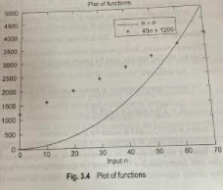

Slide 25
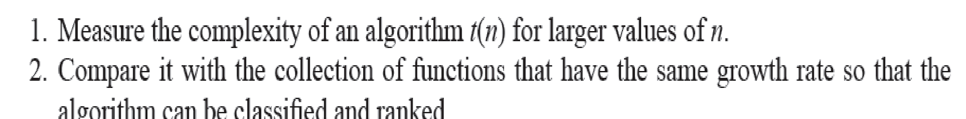
Rate of Growth –How algorithms scale?

Slide 26
let us say we run the Linear Search on a fast computer A and Binary Search on a slow computer B and we pick the constant values for the two computers so that it tells us exactly how long it takes for the given machine to perform the search in seconds. Let’s say the constant for A is 0.2 and the constant for B is 1000 which means that A is 5000 times more powerful than B.
Linear Search running time in seconds on A: 0.2 * n
Binary Search running time in seconds on B: 1000*log(n)

Slide 27
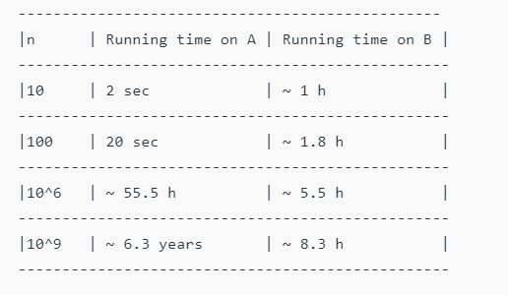

Slide 28
Does Asymptotic Analysis always work?
Asymptotic Analysis is not perfect, but that’s the best way available for analyzing algorithms. For example, say there are two sorting algorithms that take 1000nLogn and 2nLogn time respectively on a machine
Both of these algorithms are asymptotically same (order of growth is nLogn). So, With Asymptotic Analysis, we can’t judge which one is better as we ignore constants in Asymptotic Analysis.

Slide 29
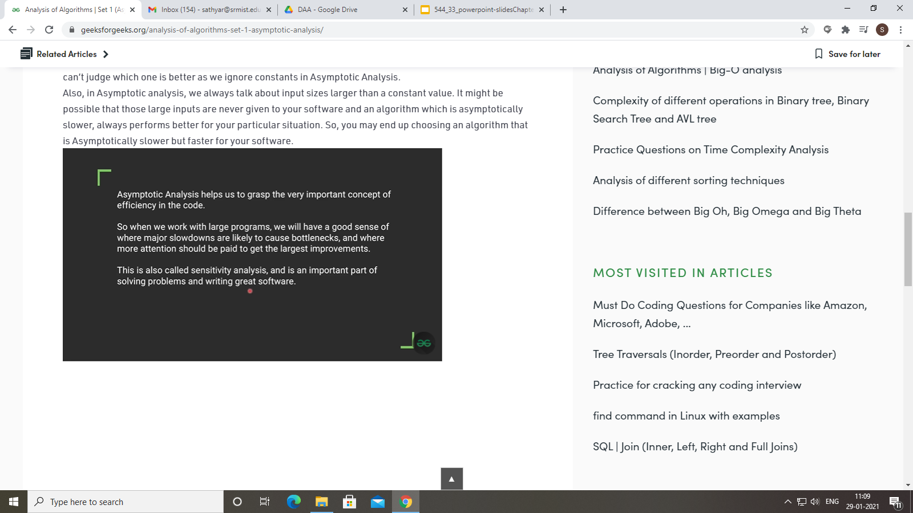

Slide 31
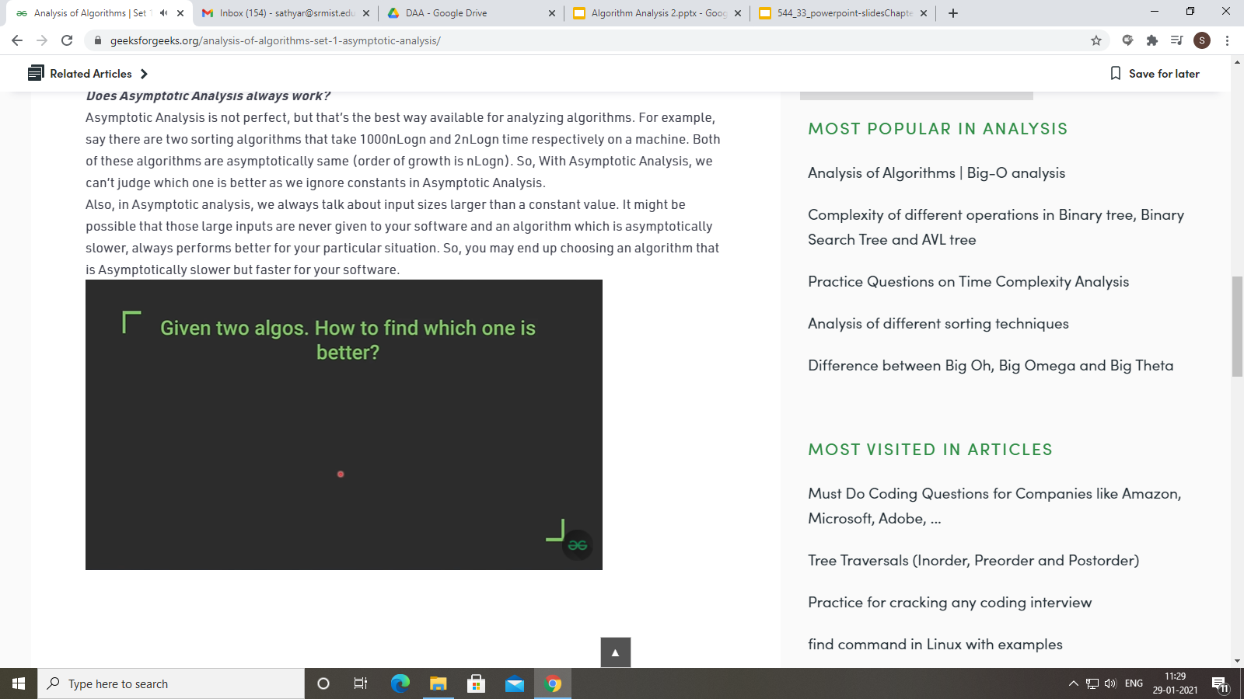

Slide 32
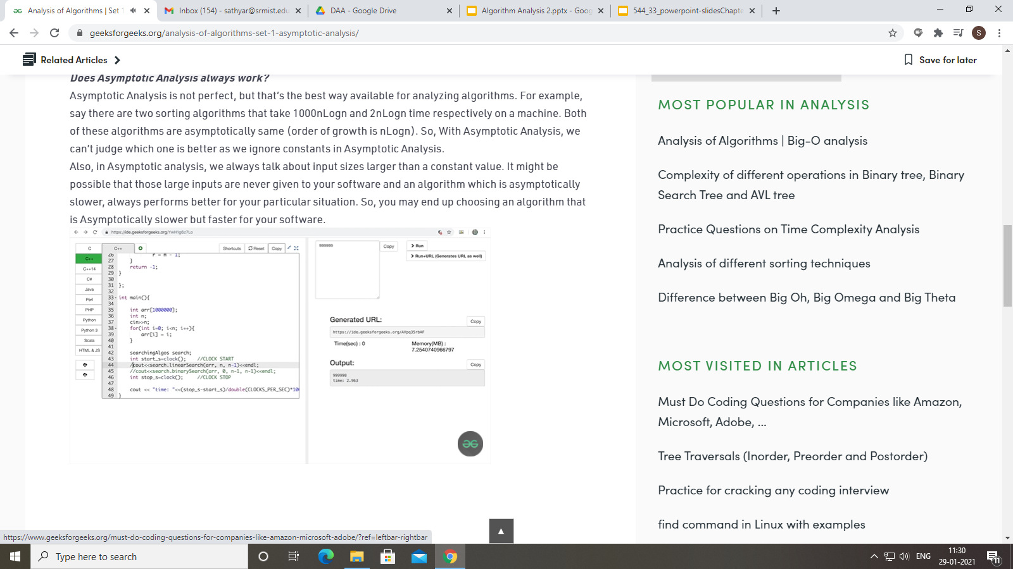

Slide 33
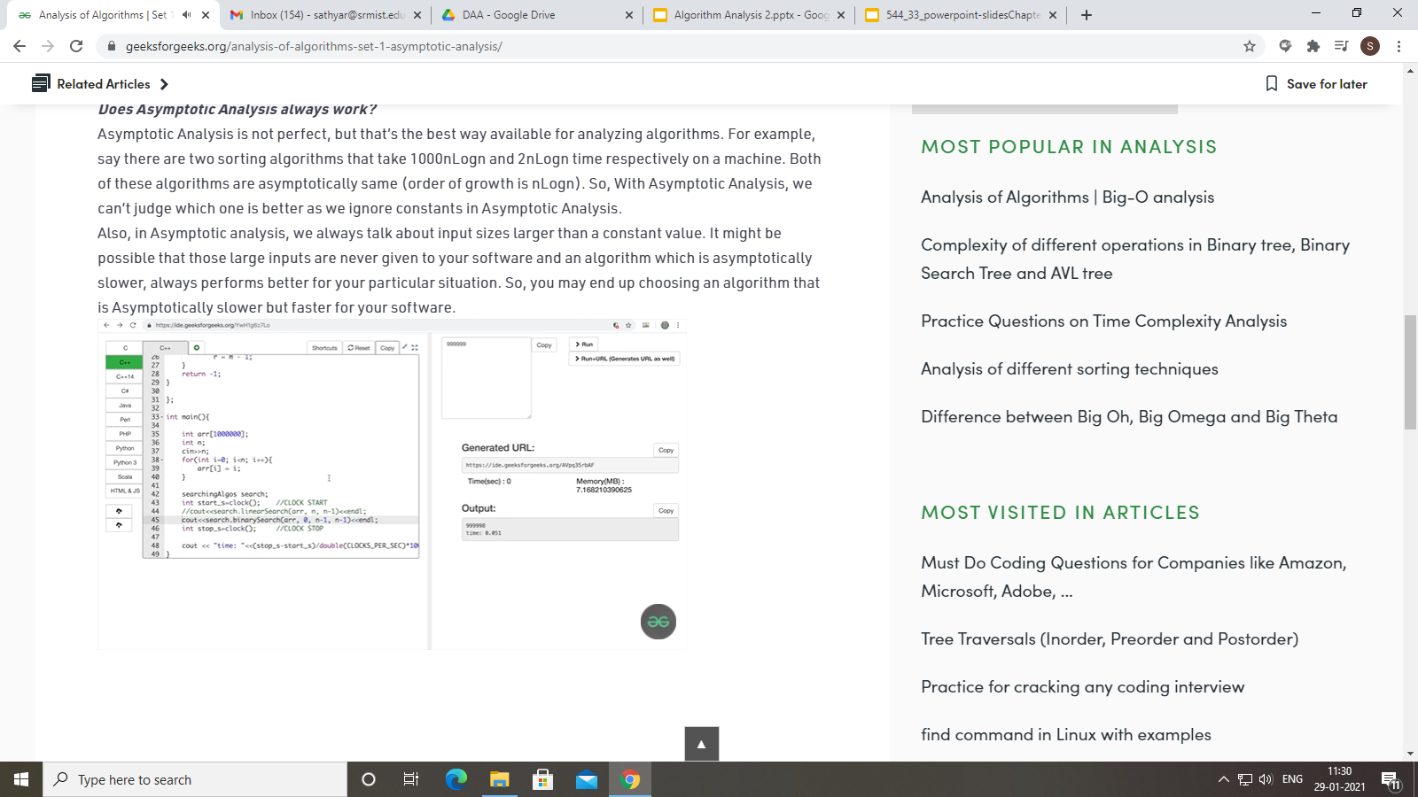

Slide 34
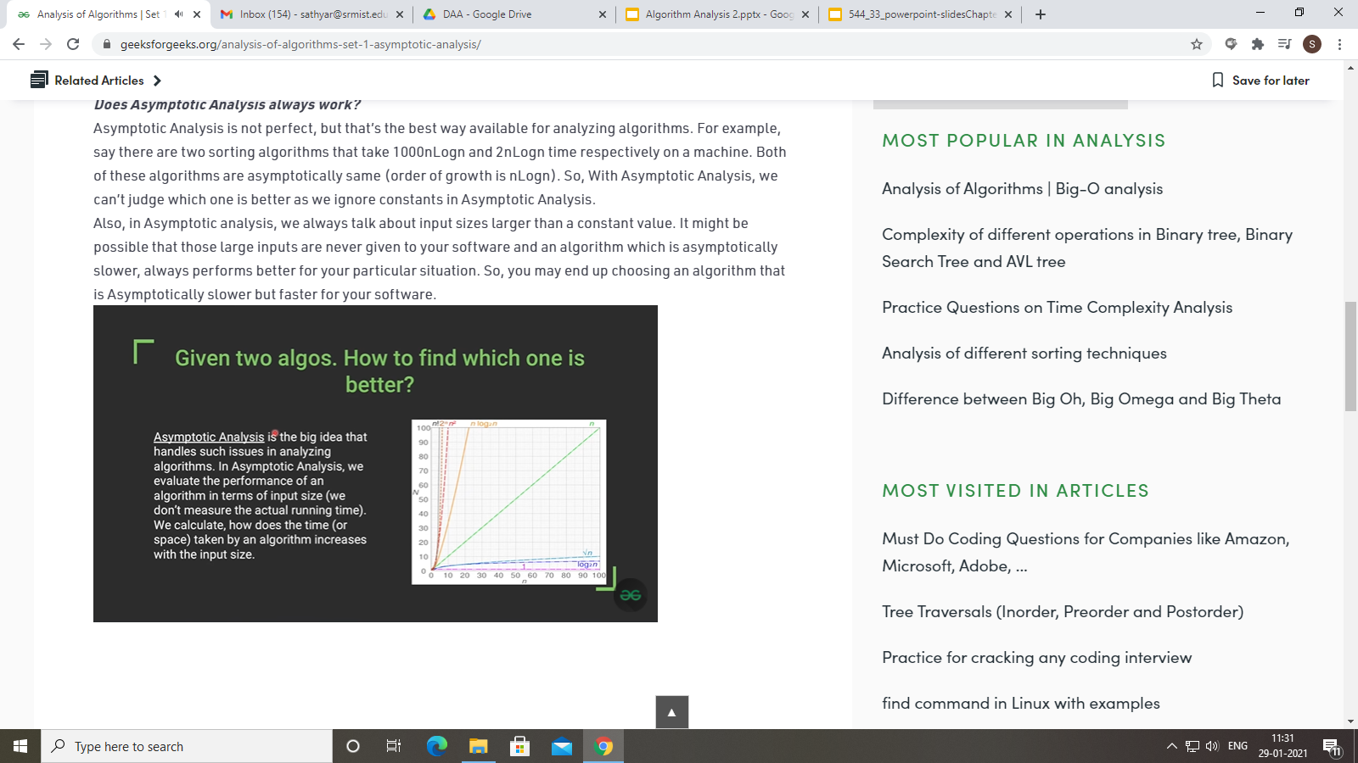

Slide 35
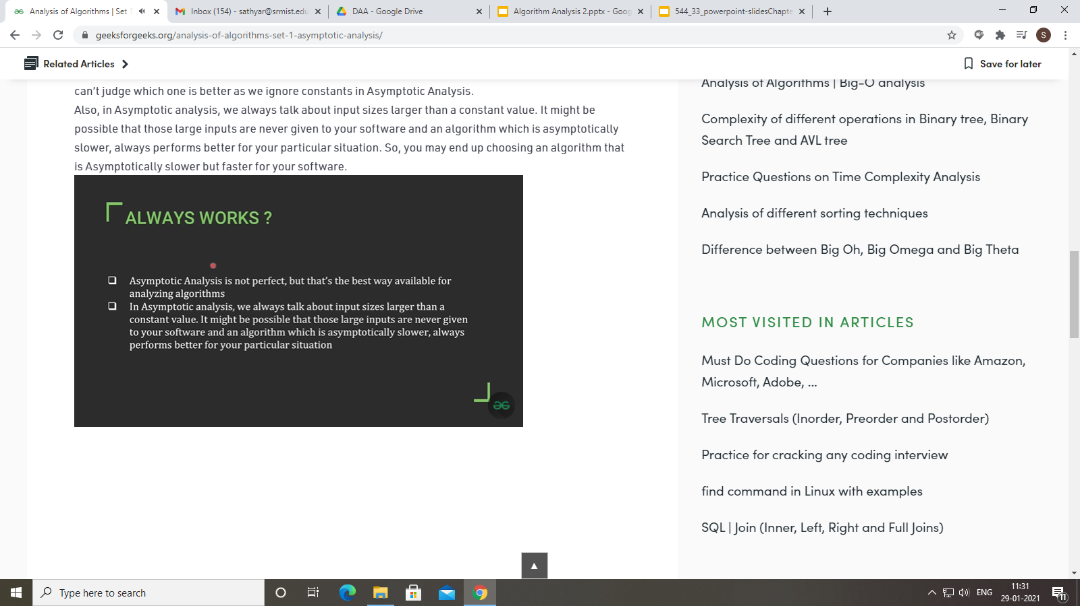

Slide 36
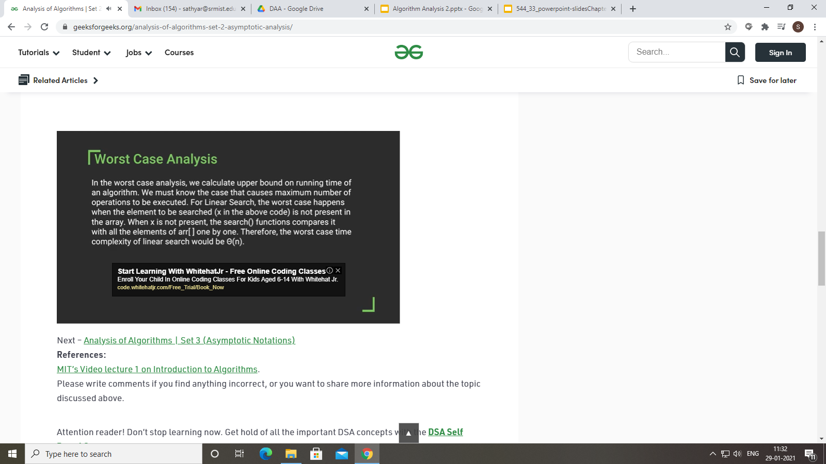

Slide 37
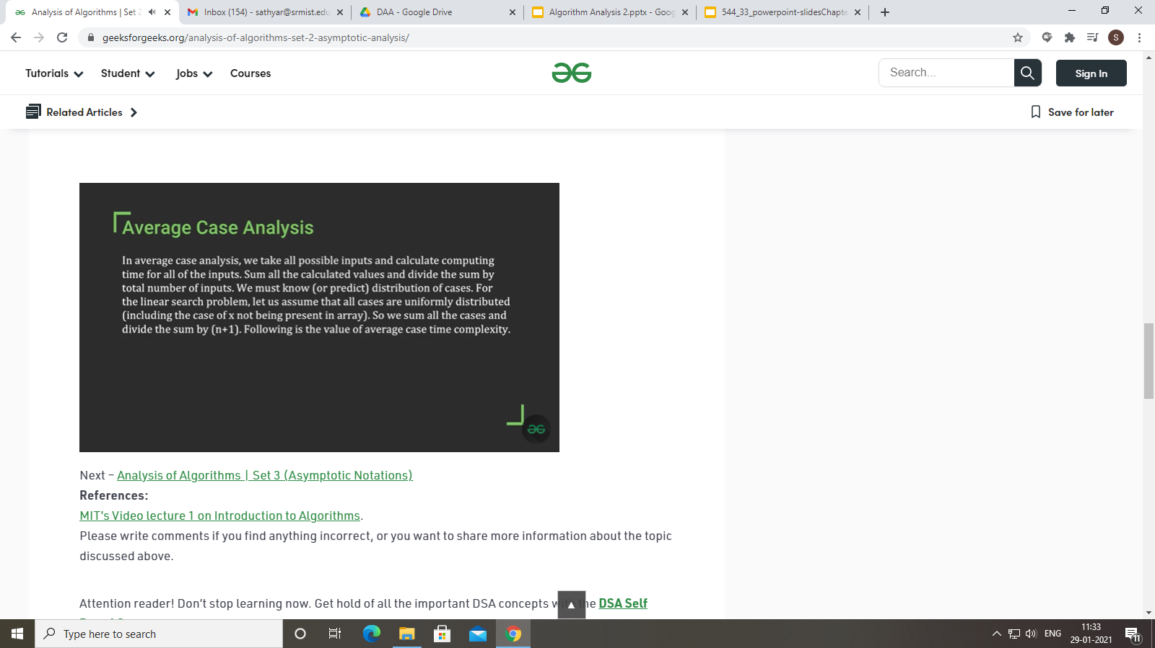

Slide 38
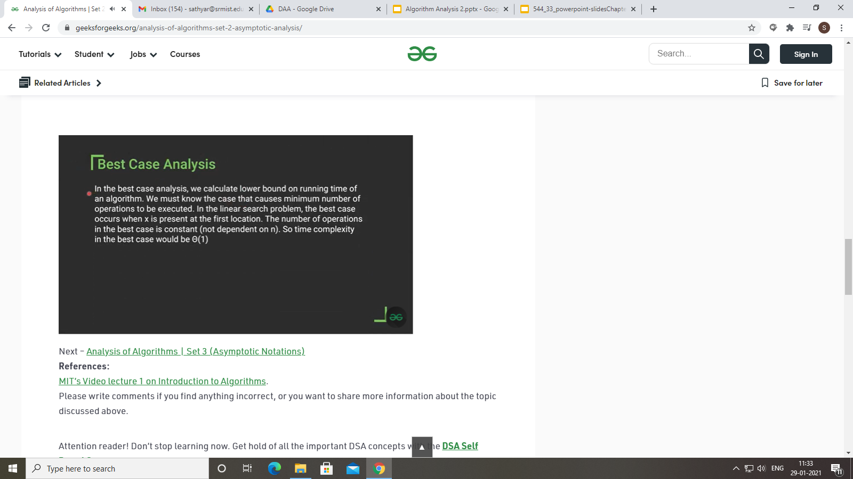

Slide 39
